Slide 1

VAAGDEVI ENGINEERING COLLEGE
AFFILIATED TO JNTUH, Hyderabad
BOLLIKUNTA,WARANGAL(T.S)-505005
MAJOR PROJECT REPORT
AGE AND GENDER DETECTION USING DEEP LEARNING
Under the Guidance of
Mrs. R. Swathi
Presented by
ERRABOINA SHESHIKUMAR (21UK1A6614)
BODDIREDDY NIDHIREDDY (21UK1A6658)
ADABOINA SHIVA (21UK1A6646)
SAKINALA SAI PRIYA (21UK1A6629)

Slide 2
ABSTRACT
Age and Gender detection from facial images. By leveraging large annotated datasets and techniques like transfer learning and data augmentation, the models achieve high accuracy in diverse conditions.
The study compares various architectures, including VGG16 and ResNet, while addressing challenges such as model bias, ethical concerns, and the importance of diverse datasets for robust and fair predictions.

Slide 3
INTRODUCTION
What is Age and Gender Detection?
Age and gender detection refers to the process of identifying a person's age group and gender based on visual cues, typically from facial images. This task is often achieved using machine learning and deep learning techniques, where models are trained on large datasets containing labeled images of faces with known age and gender information.
In age detection, the model predicts the approximate age or age group of the individual. For gender detection, the model identifies whether the individual is male or female. These tasks are widely used in applications such as personalized marketing, security systems, healthcare, and human-computer interaction, helping to tailor services or interactions based on demographic characteristics.

Slide 4
Why is Age and Gender detection Important?
Age and gender detection is important because it enables personalized experiences in various applications like marketing, healthcare, and security. By accurately predicting a person's age and gender, businesses can tailor content and advertisements, healthcare providers can offer age-appropriate care, and security systems can enhance identity verification. Additionally, it plays a key role in improving user interactions in social media and human-computer interfaces.

Slide 5
Problem Statement
Age and gender detection from images poses challenges due to diverse real-world conditions like
varying facial structures, lighting, and ethnic backgrounds. Traditional computer vision methods
struggle to generalize across these factors, leading to inaccuracies. Additionally, privacy concerns,
ethical issues, and difficulties in handling ambiguous or non-binary gender representations complicate
the development of reliable, automated systems for age and gender detection.

Slide 6
Proposed Solution
What We Propose: A real-time Age and Gender detection powered by deep learning to
provide age group and gender from facial images.
How It Helps:
By accurately predicting a person's age and gender, businesses can tailor content and advertisements, healthcare providers can offer age-appropriate care, and security systems can enhance identity verification. Additionally, it plays a key role in improving user interactions in social media and human-computer interfaces.
Key Features of the Solution:
1. Hybrid Model Architecture:
This hybrid architecture eliminates the limitations of traditional RNN-based approaches,improving both the speed and accuracy of the system, while making it more robust in diverse conditions.
2.Attention Mechanism:
The attention mechanism will be particularly useful in images with multiple people or complex backgrounds, as it will guide the model to focus only on the relevant facial features, improving both accuracy and contextual relevance.

Slide 7
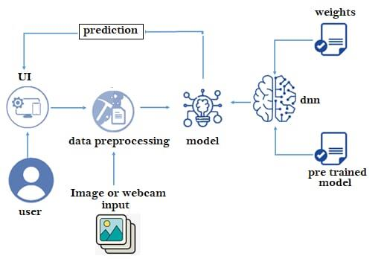
BLOCK DIAGRAM

Slide 8
Methodology
1.User: The person interacting with the system. They provide input through an image or webcam.
2. Image or Webcam Input: The raw data provided by the user for analysis or prediction.
3. Data Preprocessing: The input data undergoes preprocessing to prepare it for the model. This step
may include resizing, normalization, feature extraction, or other transformations.
4. Model: The core of the system, which could be a neural network or other machine learning model. It
processes the preprocessed data to generate predictions.
5. Pretrained Model: A model that has already been trained on a dataset, serving as a starting point. It
provides initial knowledge for the task.
6. Weights: These are the parameters of the model that are adjusted during training. They play a crucial
role in determining the model's performance.
7. dm (Deep Model): This could represent the deep learning model being used, incorporating the
pretrained model and its updated weights.
8. Prediction: The final output or decision made by the model based on the processed input data.
9. UI (User Interface): The interface through which the user interacts with the system and receives
predictions.

Slide 9
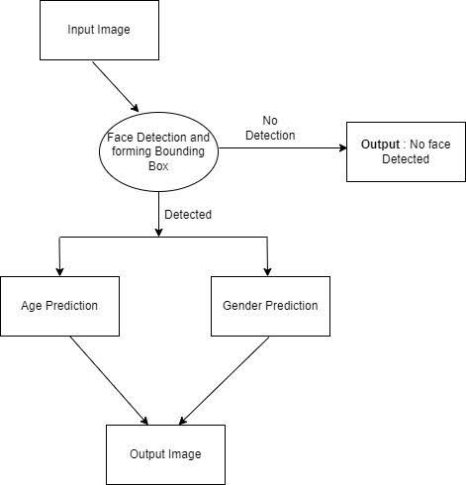
Flowchart

Slide 10
Results
Home Page
Predict Page

Slide 11
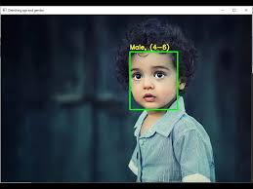
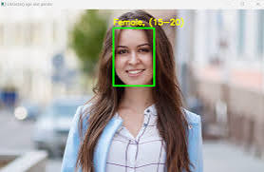
Output

Slide 12
Advantages
Disadvantages
High Accuracy
Real-time Performance
Robustness
scalability
Minimal Human Intervention
Bias and fairness issues
Ethical concerns
Data Dependency
Ambiguities in gender and age
computational cost

Slide 13
Conclusion
The Age and Gender Detection using Deep Learning system, we successfully laid the foundation for a robust and scalable solution to the problem of automatic age and gender classification from facial images. The project effectively integrates cutting-edge deep learning techniques to offer accurate predictions, leveraging the strengths of Convolutional Neural Networks (CNNs) for feature extraction and transformer-based architectures or Long Short-Term Memory (LSTM)networks for contextual understanding. The ability of these models to learn hierarchical features from facial images and process them for accurate classification is crucial in tackling age and gender prediction tasks.

Slide 14
Thank You

